Slide 1

Standard for Spatial Accessibility
Alexander Prokic, Leon Liang, Muhammad Jahangir, Nils Strand

Slide 2

Introduction
Current indoor navigation for those with visual impairment is non-existent.
SSA provides RFID-based global indoor and urban outdoor audio navigation and spatial awareness.
The software is being developed in conjunction with a draft ISO standard, to allow for widespread adoption and implementation. Development progress will be provided to the University of Michigan for continued development in 2017 by Dr. David Chesney and team.

Slide 3
Stakeholder Objectives & Engineering Requirements
An ideal system would deliver descriptive and comprehensive audio information about at a minimum, all points of interest within a space.
The SSA system should require the least amount of effort and monetary onus on both the part of the site owner and user.
The addressing scheme of RFID tags should allow for systematic and exhaustive description of all locations and items on the planet.
The addressing scheme of RFID tags should also be extensible, so as to allow for future modification and expansion.
The SSA should provide an open platform, so as to be implemented by any designer, thus increasing interest, competition and reducing costs to a minimum.

Slide 4
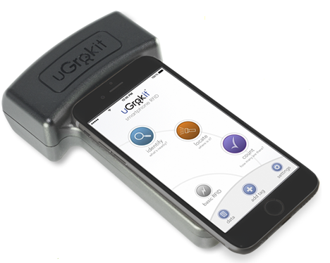
Visual System Maps

Slide 5
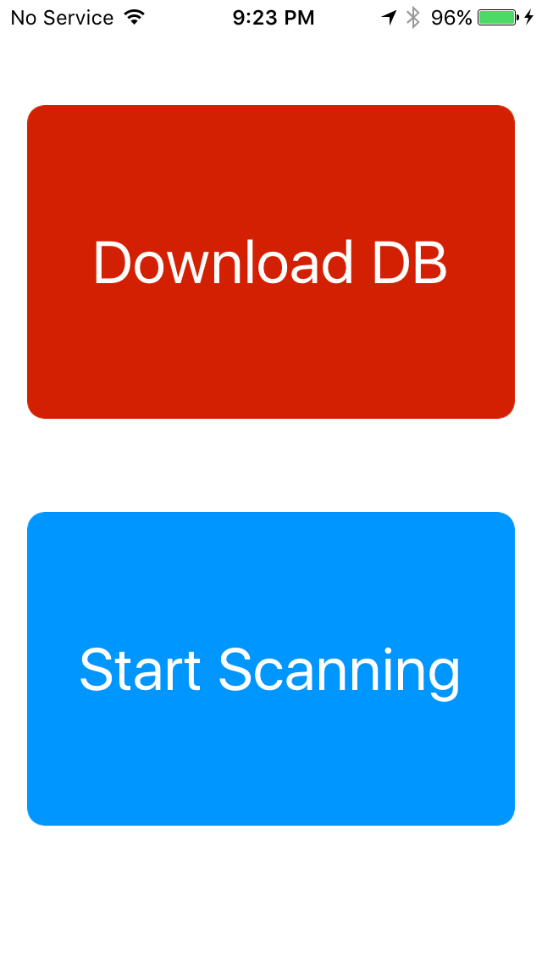

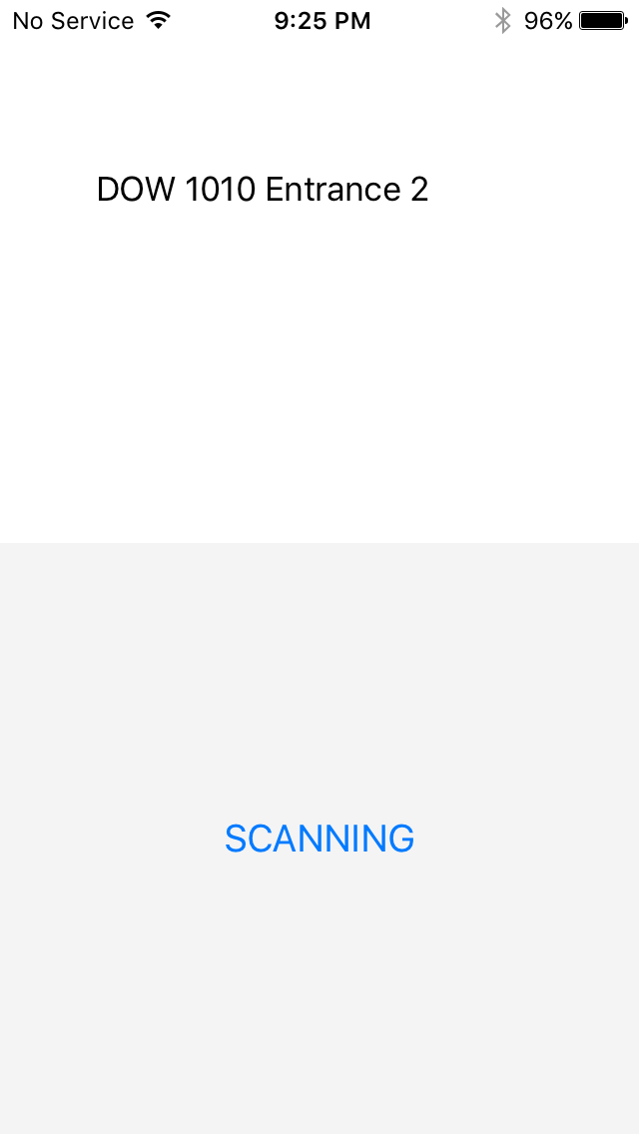
Typical Usage Case
User is presented with main menu.
User selects country, region, city from remote DB.
Scanner finds close RFIDs and reads description from DB.

Slide 6
Validation Methodologies
Validation of stakeholder objectives have been tested as follows:
Following the SSA ISO documentation, are we able to navigate a space without sight or other assistance?
Is the addressing scheme extensible and accommodating of all objects on Earth?
Is the system design in its current form, affordable to users and site owners living near the average world income?
Are there any parts of the system design which don’t allow for open standards and competition?

Slide 7
Validation Results
Each result corresponds to the same number methodology mentioned above.
Testing this in full requires purchase and placement of more expensive and hard to place active RFID tags, which we have not procured.
Our current addressing is both systematic, and would allow for:
  256 item/location types
  68.7 billion addresses
  4.3 billion items/locations per address
  20 bits of extensibility

Slide 8
Validation Results (continued)
Each result corresponds to the same number methodology mentioned above.
While limited by existing data, the UN’s International Labour Organization calculated the average worker income to be $1,480 in 2012. This puts the cost of our current implementation ($500 + smart phone) at nearly ½ their monthly income and out of reach. Site owners are likely to be able to afford the system, which would start at less than $1000 for a small site.
Current implementation requires the UGrokIt RFID reader, which is proprietary and has at least a pending patent for the technology. This is a barrier to open implementation. A modified version of this tech would have to be developed by another company or incorporated into a phone chipset.

Slide 9
Conclusions &
Recommendations
SSA shows great potential in using RFID tags to help those with visual impairment navigate spaces. While the current implementation is still an expensive one, it achieves its functional goals, while still presenting some monetary barriers to adoption.
SSA right now is incapable of supporting headphones due to the RFID reader’s hijacking of the port. A more flexible reader should be found, that allows, either through software or hardware, the usage of headphones.
While we have drafted an ISO standard for all RFID tags to follow, organizations that wish to use SSA in their buildings or spaces still require an organization to send their tags to for review before being added to the database. We recommend having a web interface for organizations to enter their RFID tag bits, descriptions, locations, etc, for a review board to approve.

